Slide 1
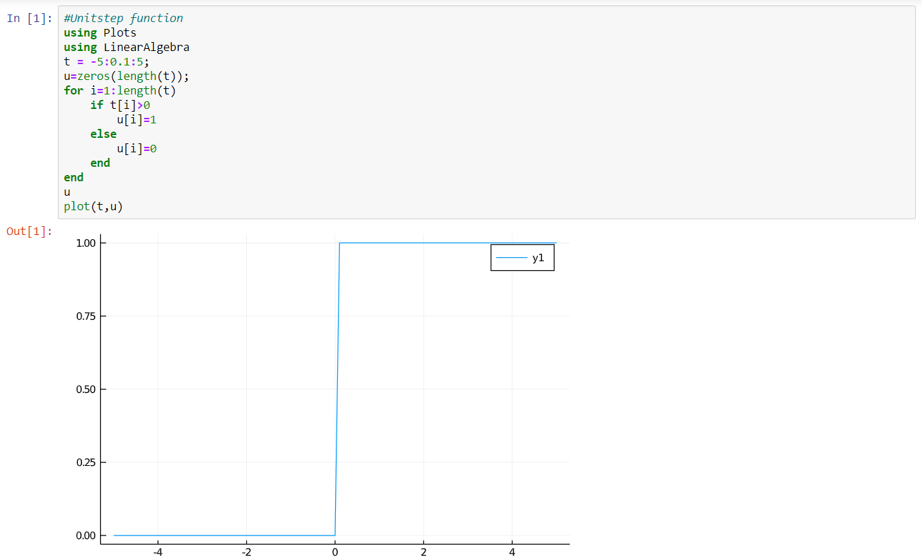
Q1|GENERATE AND DISPLAY ELEMENTARY SIGNALS-CONTINUOUS

Slide 2
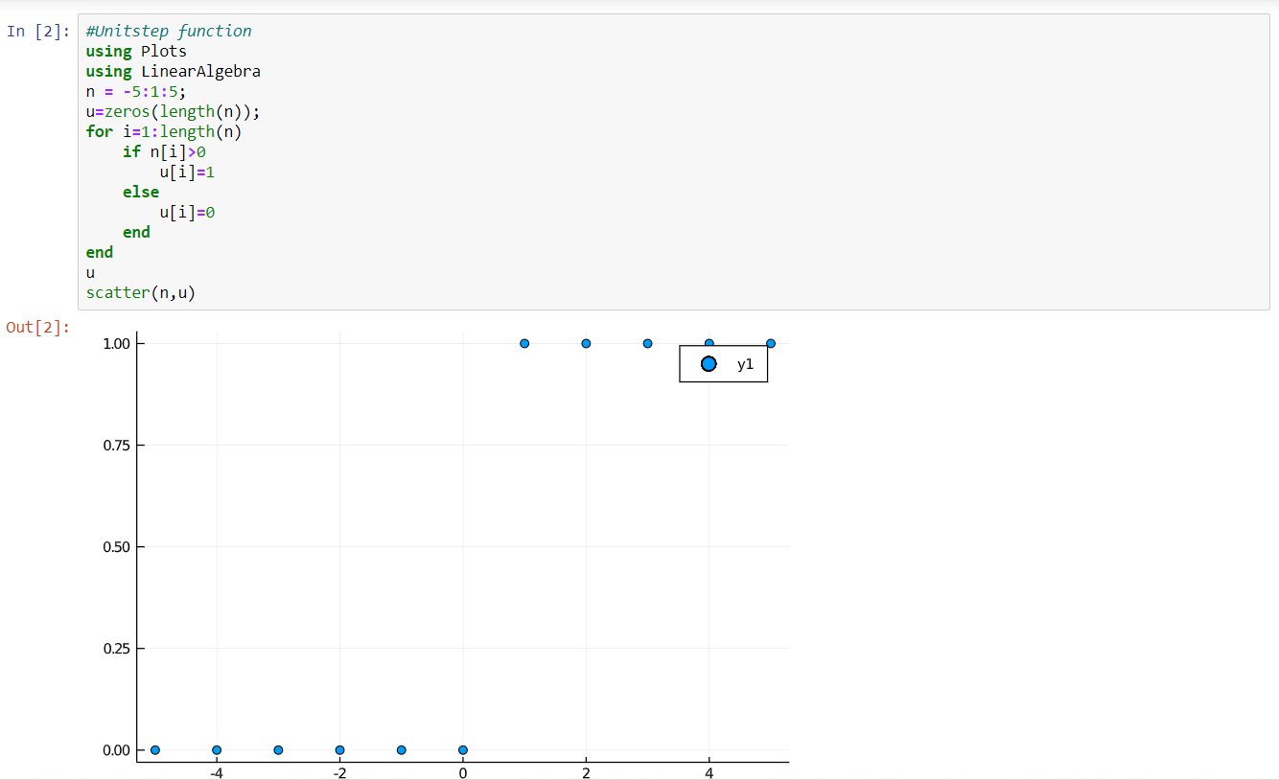
Q1|GENERATE AND DISPLAY ELEMENTARY SIGNALS-DISCRETE

Slide 3
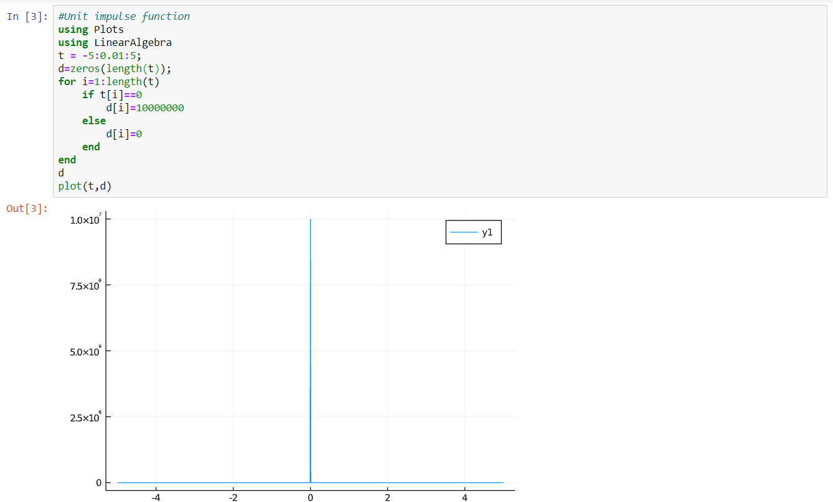
Q1|GENERATE AND DISPLAY ELEMENTARY SIGNALS-CONTINUOUS

Slide 4
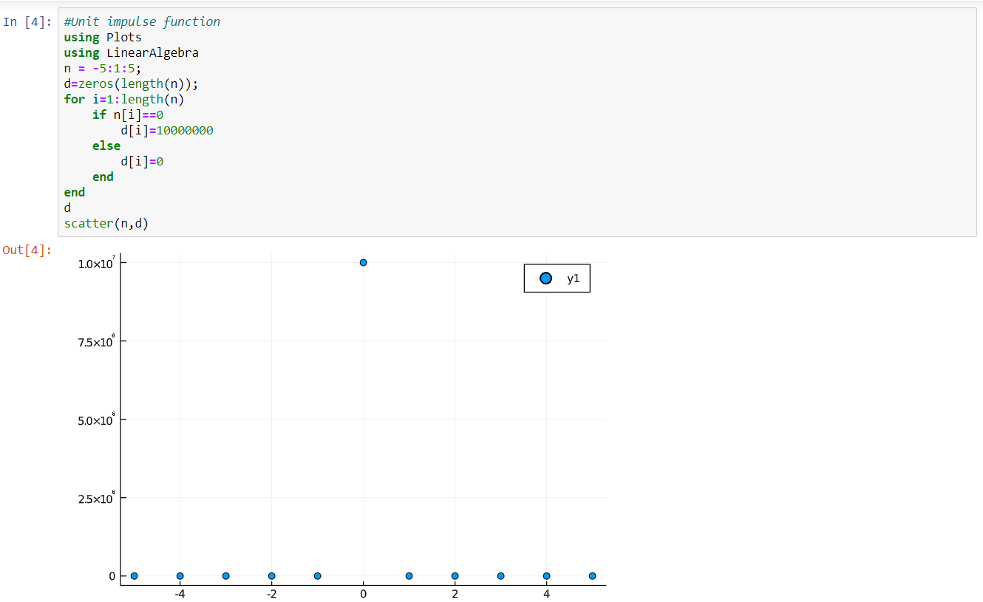
Q1|GENERATE AND DISPLAY ELEMENTARY SIGNALS-DISCRETE

Slide 5
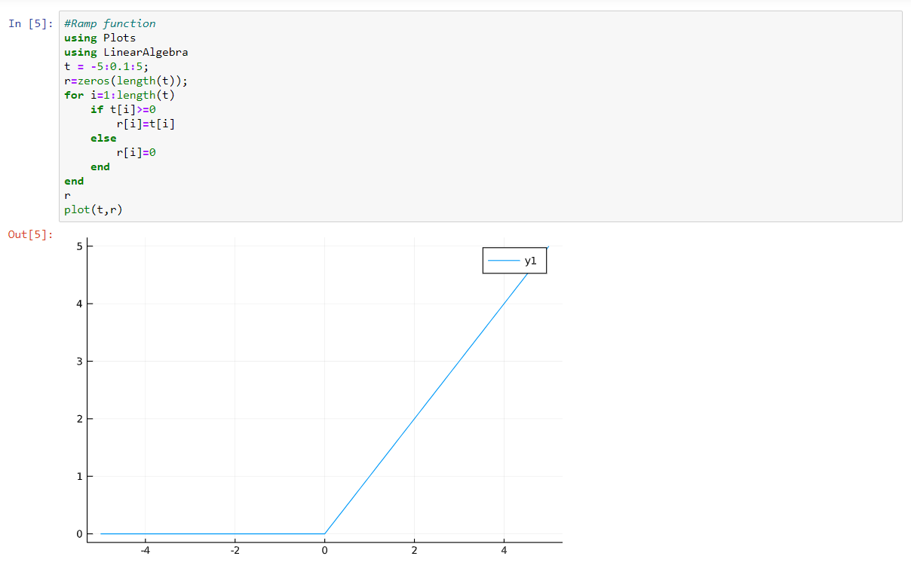
Q1|GENERATE AND DISPLAY ELEMENTARY SIGNALS-CONTINUOUS

Slide 6
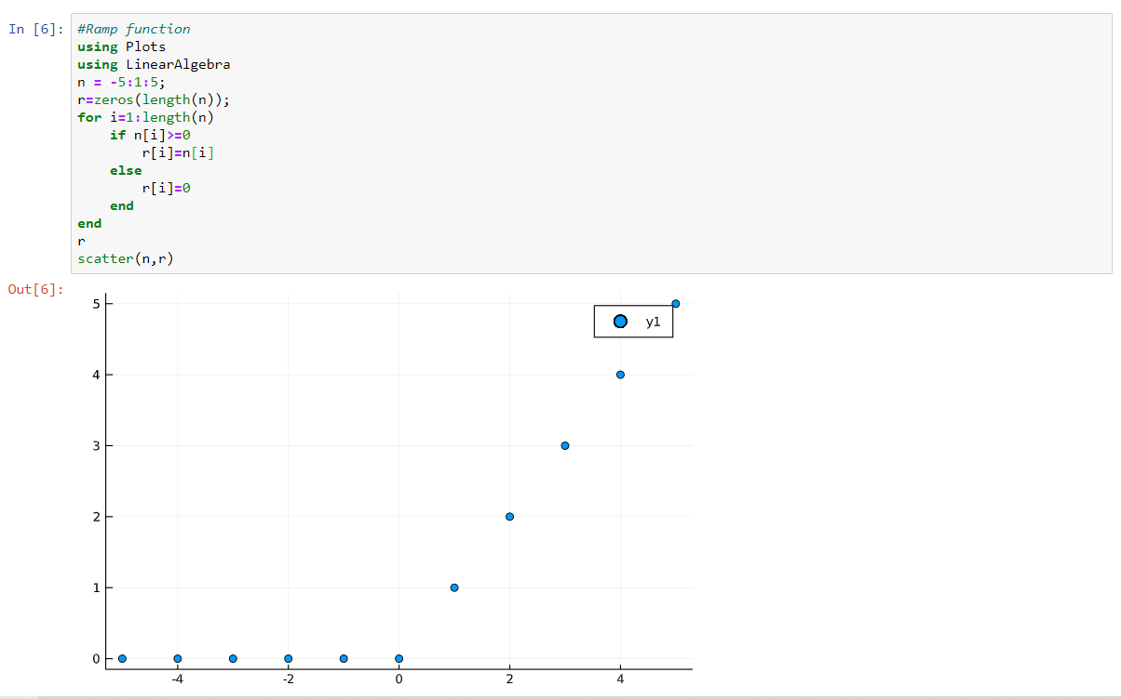
Q1|GENERATE AND DISPLAY ELEMENTARY SIGNALS-DISCRETE

Slide 7
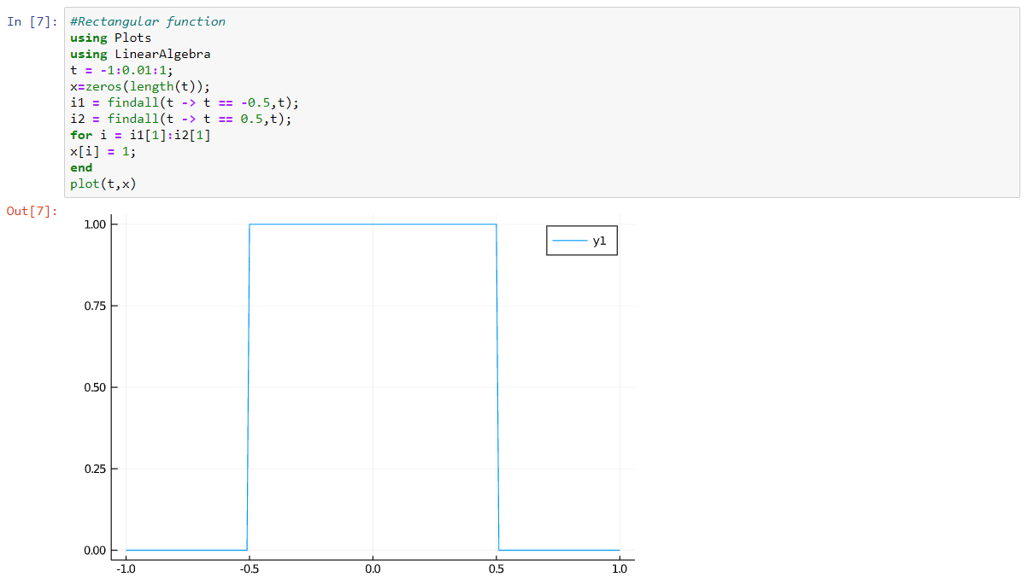
Q1|GENERATE AND DISPLAY ELEMENTARY SIGNALS-CONTINUOUS

Slide 8
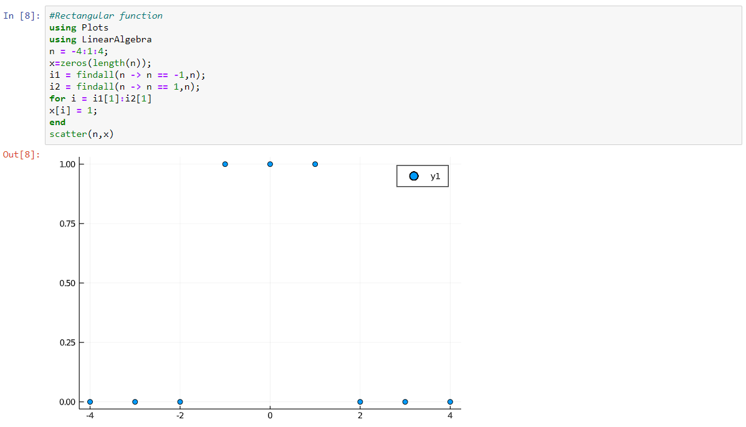
Q1|GENERATE AND DISPLAY ELEMENTARY SIGNALS-DISCRETE

Slide 9
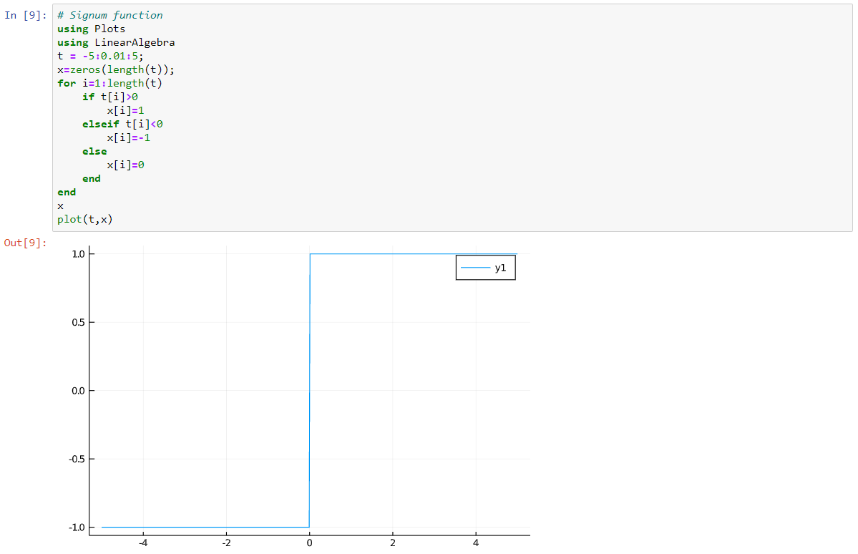
Q1|GENERATE AND DISPLAY ELEMENTARY SIGNALS-CONTINUOUS

Slide 10
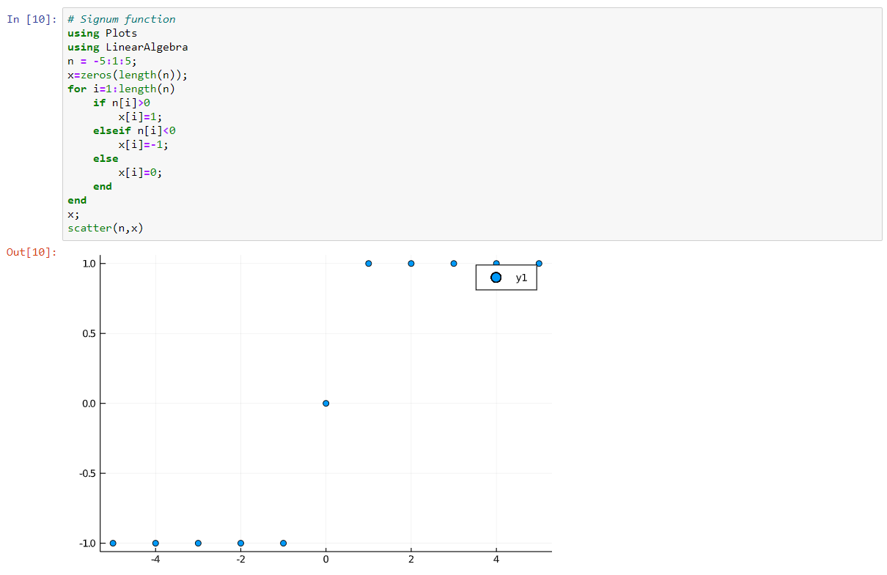
Q1|GENERATE AND DISPLAY ELEMENTARY SIGNALS-DISCRETE

Slide 11
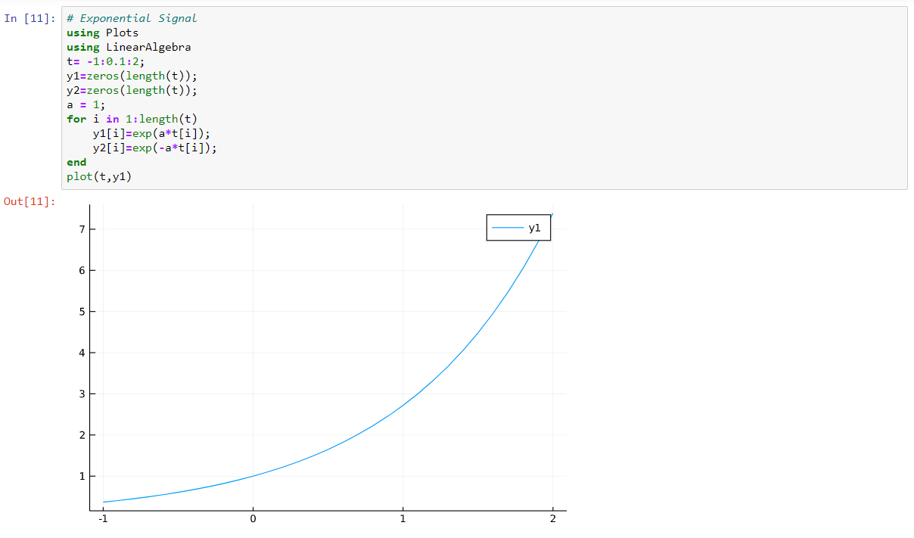
Q1|GENERATE AND DISPLAY ELEMENTARY SIGNALS-CONTINUOUS

Slide 12
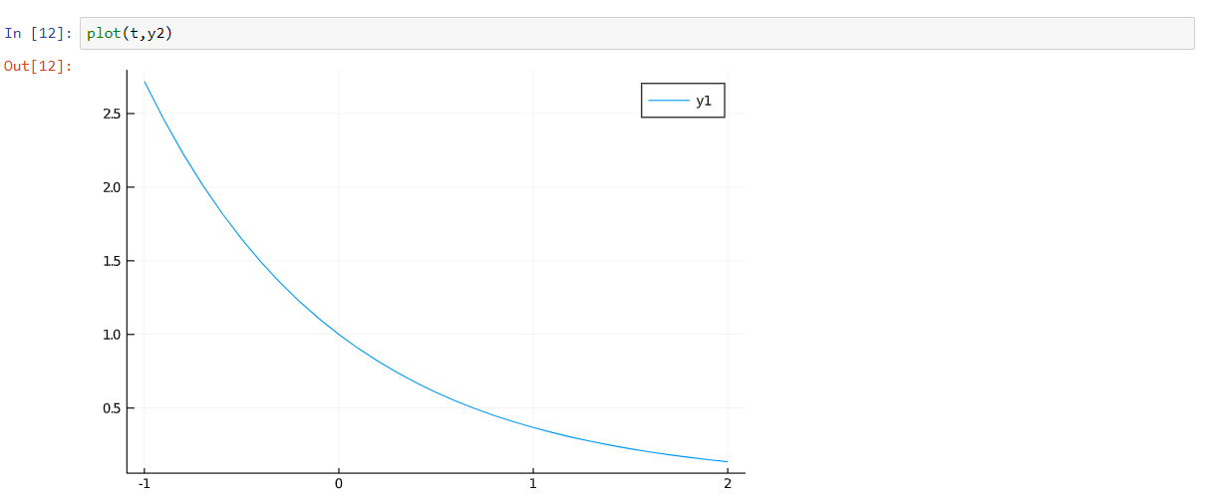
Continued…

Slide 13
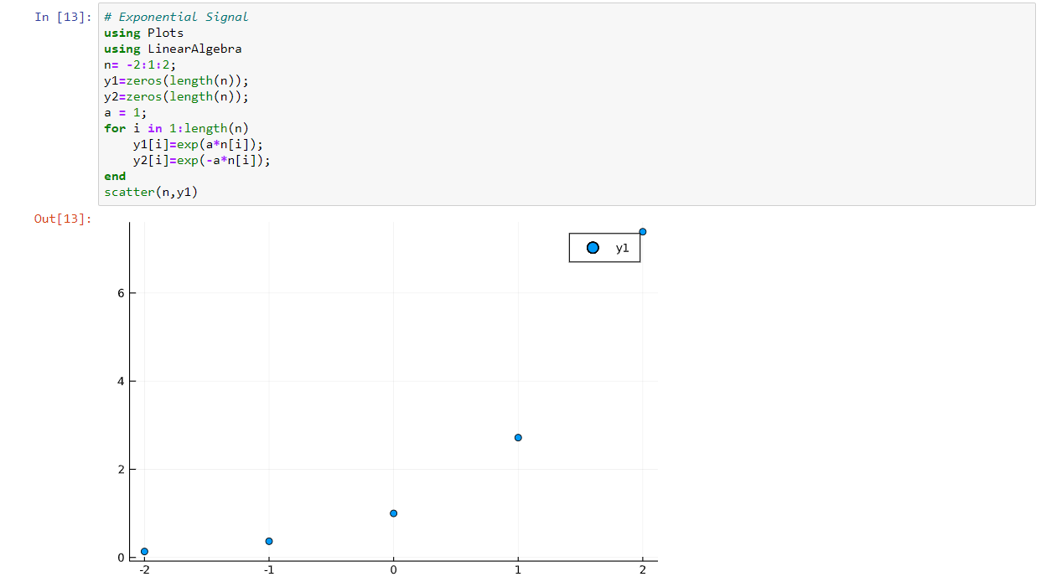
Q1|GENERATE AND DISPLAY ELEMENTARY SIGNALS-DISCRETE

Slide 14
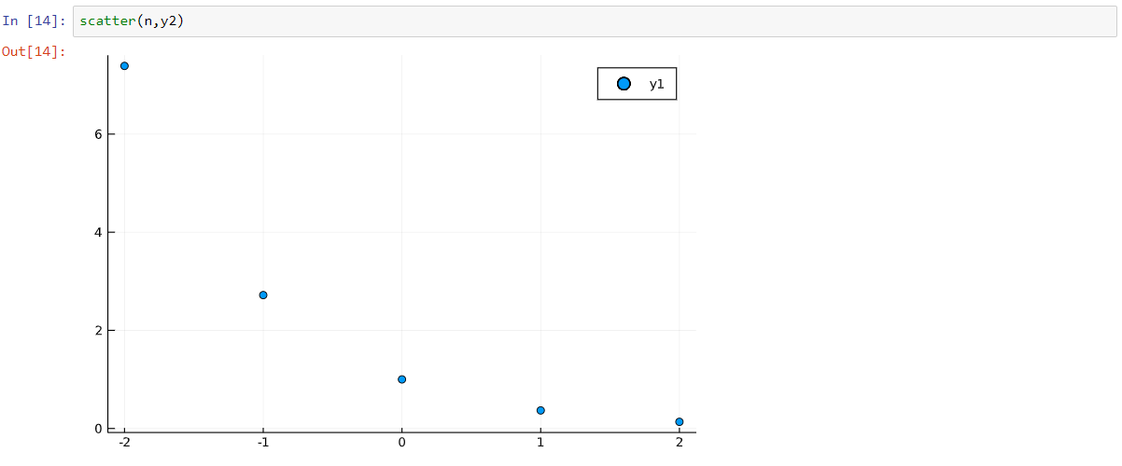
Continued…

Slide 15
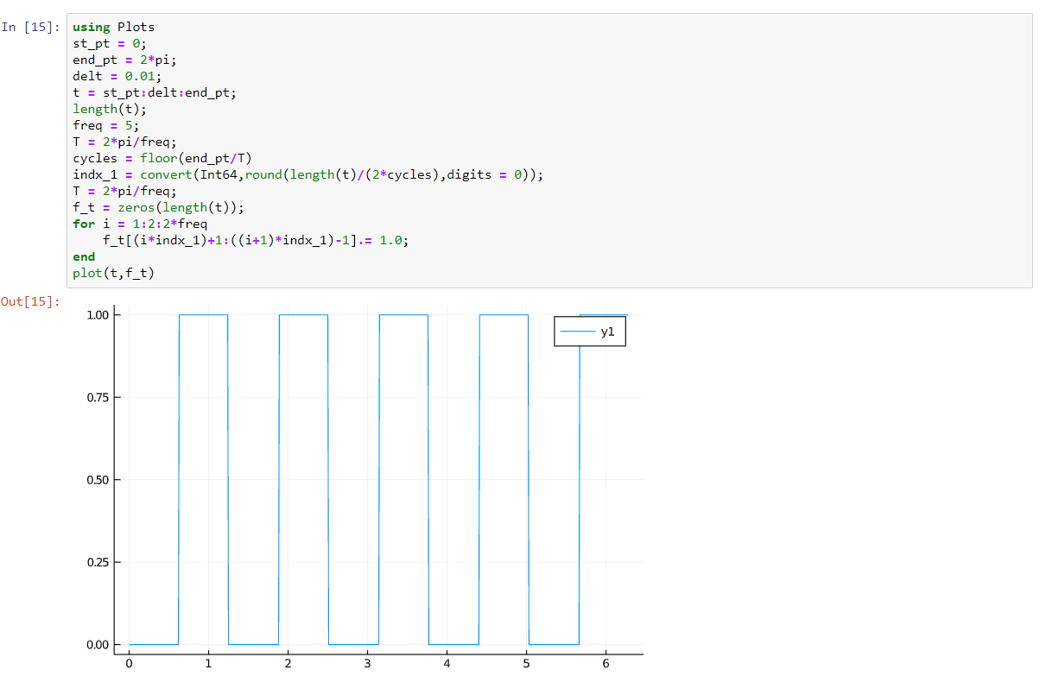
Q2|Generate and display a periodic square waveform of frequency 5Hz.

Slide 16
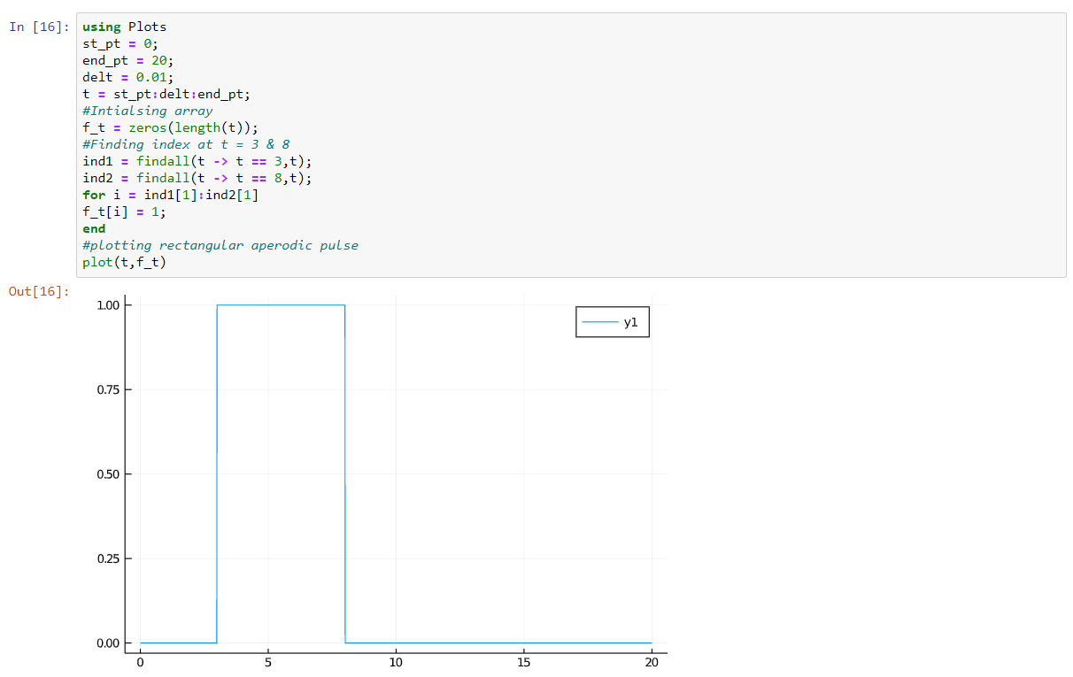
Q3|Generate and display a rectangular aperiodic pulse

Slide 17

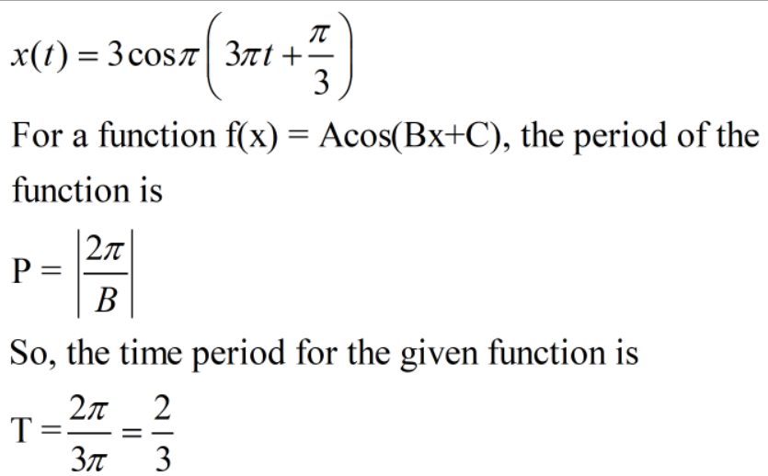
Q4|Generate THE FOLLOWING SIGNAL IN 4 PERIODS:

Slide 18
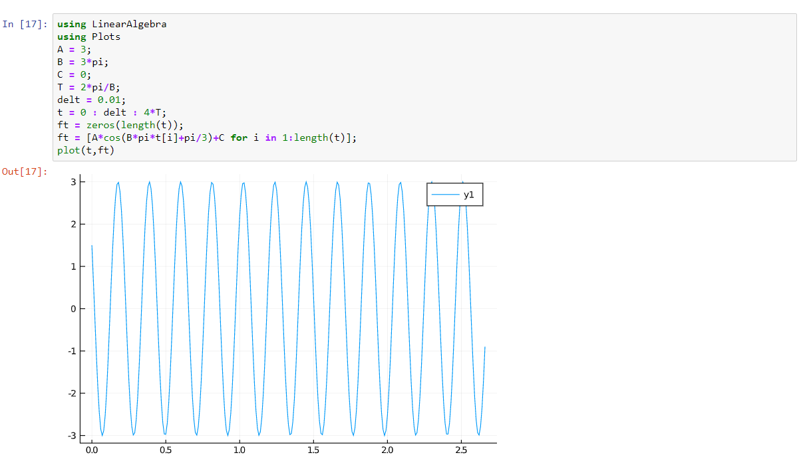
Q4|Generate THE FOLLOWING SIGNAL IN 4 PERIODS:

Slide 19

Q5|Separate the following unit step sequence into even and odd parts and display the same
Number(n) | -5 | -4 | -3 | -2 | -1 | 0 | 1 | 2 | 3 | 4 | 5
u(n) | 0 | 0 | 0 | 0 | 0 | 1 | 1 | 1 | 1 | 1 | 1
u(-n) | 1 | 1 | 1 | 1 | 1 | 1 | 0 | 0 | 0 | 0 | 0
u(even) | 0.5 | 0.5 | 0.5 | 0.5 | 0.5 | 1 | 0.5 | 0.5 | 0.5 | 0.5 | 0.5
u(odd) | -0.5 | -0.5 | -0.5 | -0.5 | -0.5 | 0 | 0.5 | 0.5 | 0.5 | 0.5 | 0.5

Slide 20
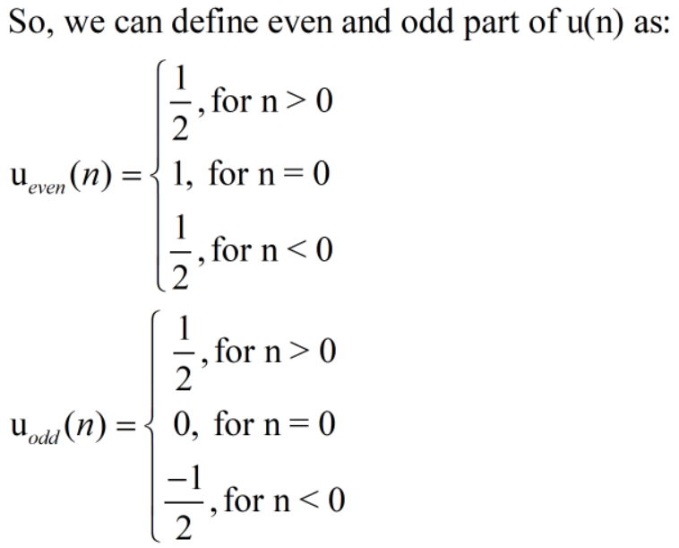
Q5|Separate the following unit step sequence into even and odd parts and display the same

Slide 21
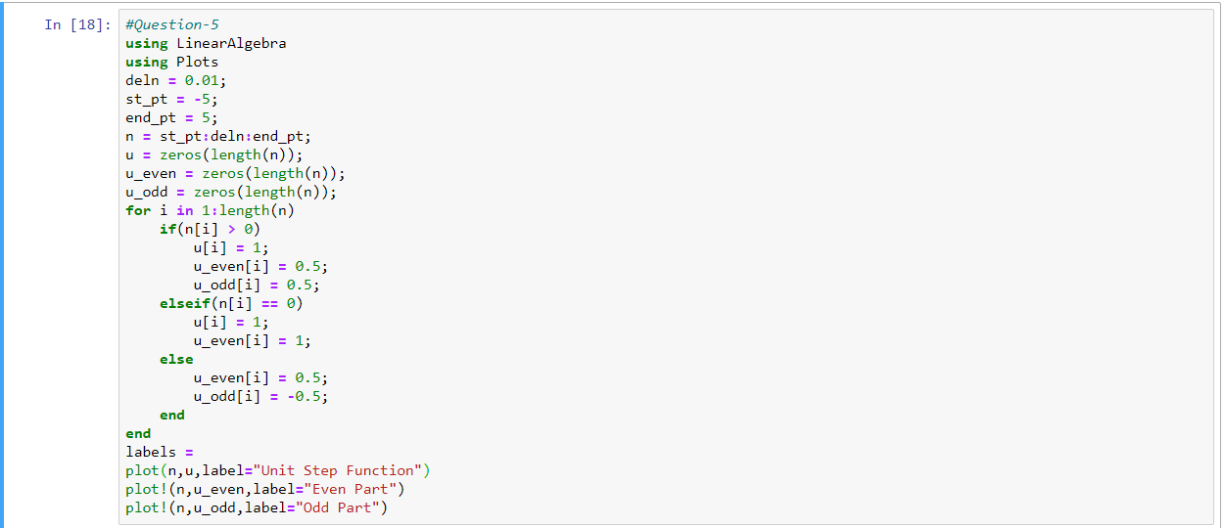
Q5|Separate the following unit step sequence into even and odd parts and display the same

Slide 22
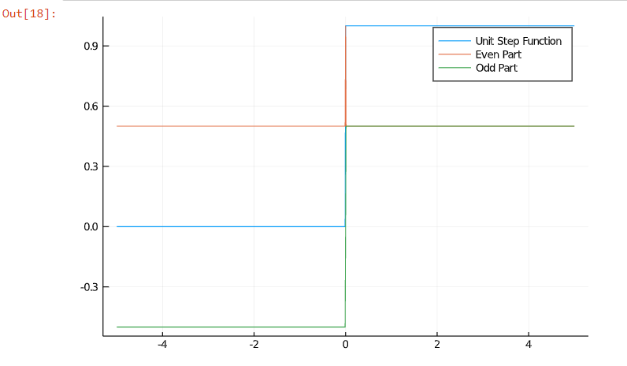
Continued…

